Slide 1
Chương 1 Giới thiệu
ĐHBK Tp HCM - Khoa Đ-ĐT
BMĐT
Môn học: Xử lý tín hiệu số với FPGA
GVPT: Nguyễn Lý Thiên Trường
Email: truongnguyen@hcmut.edu.vn
203-B3

Slide 2
Digital System Design with Verilog

Slide 3
Combinational Circuit

Slide 4
Outline
Conditional operator
if-else statement
case statement
casez, casex
Examples

Slide 5
Combinational circuits
inputs
0
outputs
1
w
0
y
0
w
1
y
1
y
2
En
y
3
1) Outputs only depend on inputs
2) Could include: gates, multiplexers, encoders, decoders, code converters, comparators …
3) Verilog description: gates, logic expression, behavior

Slide 6
Conditional operator
Format
Conditional_expression ? true_expression : false_expression
Behavior
If the conditional expression is 1 (true), then the value of true_expression is chosen;
Otherwise, the value of false_expression is chosen
Example
A = (B<C) ? (D+5) : (D+2);
Can be used in continuous assign and procedural statements

Slide 7
2-to-1 multiplexer
Behavior
s
s
f
w
0
0
0
w
0
w
f
1
w
1
1
1
Logic expression
w
0
s
f
w
1
Gates

Slide 8
Multiplexer examples
module mux2to1 (w0, w1, s, f);
input w0, w1, s;
output f;
assign f = s ? w1 : w0;
endmodule
Conditional operator
in continuous assignment
s
w
0
0
w
f
Conditional operator
in procedural statement
1
1
module mux2to1 (w0, w1, s, f);
input w0, w1, s;
output f;
reg f;
always @(w0 or w1 or s)
f = s ? w1 : w0;
endmodule
Remember
f is reg
Include all input signals
Blocking assignment

Slide 9
4-to-1 multiplexer
s
0
s
s
s
f
1
1
0
w
0
00
0
0
w
0
w
1
01
f
0
1
w
1
w
2
10
1
0
w
w
3
11
w
2
1
1
3
s
1
s
s
0
0
w
0
s
1
w
0
0
w
1
w
1
1
f
w
0
f
2
1
w
2
0
w
3
w
3
1

Slide 10
Nesting conditional operators
module mux4to1 (w0, w1, w2, w3, S, f);
input w0, w1, w2, w3;
input [1:0] S;
output f;
assign f = S[1] ? (S[0] ? w3 : w2) : (S[0] ? w1 : w0);
endmodule
s
1
s
0
s
0
w
s
s
s
f
0
0
1
1
0
w
0
00
0
0
w
0
w
1
1
w
1
01
f
0
1
w
1
w
2
10
1
0
w
0
w
3
11
w
2
f
1
1
3
1
w
2
0
w
3
1

Slide 11
if-else
Format
if (conditional_expression) statement;
else statement;
Behavior
If the conditional_expression is true, then the first statement is executed;
Or else the second statement is executed.
Used inside an always block, the statements are procedural.

Slide 12
if-else examples
module mux2to1 (w0, w1, s, f);
input w0, w1, s;
output f;
reg f;
always @(w0 or w1 or s)
if (s==0)
f = w0;
else
f = w1;
endmodule
reg data type
Include all input signals
s
s
f
w
0
0
0
w
0
w
f
1
w
1
1
1

Slide 13
if… else if…else
module mux4to1 (w0, w1, w2, w3, S, f);
input w0, w1, w2, w3;
input [1:0] S;
output f;
reg f;
always @(w0 or w1 or w2 or w3 or S)
if (S == 2'b00)
f = w0;
else if (S == 2'b01)
f = w1;
else if (S == 2'b10)
f = w2;
else // S == 2'b11
f = w3;
endmodule
module mux4to1 (W, S, f);
input [0:3] W;
input [1:0] S;
output f;
reg f;
always @(W or S)
if (S == 0)
f = W[0];
else if (S == 1)
f = W[1];
else if (S == 2)
f = W[2];
else // S == 3
f = W[3];
endmodule
s
0
s
1
w
0
00
w
1
01
f
w
2
10
w
3
11

Slide 14
s
0
s
1
w
0
w
3
w
s
4
2
s
3
w
7
f
w
8
w
11
w
12
w
15
A 16-to-1 multiplexer.

Slide 15
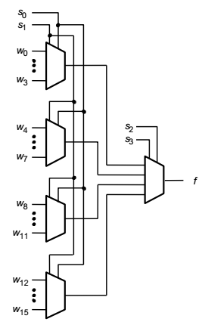
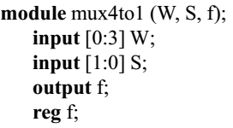
Hierarchical 16-to-1 Multiplexer
module mux16to1 (W, S16, f);
input [0:15] W;
input [3:0] S16;
output f;
wire [0:3] M;
mux4to1 Mux1 (W[0:3], S16[1:0], M[0]);
mux4to1 Mux2 (W[4:7], S16[1:0], M[1]);
mux4to1 Mux3 (W[8:11], S16[1:0], M[2]);
mux4to1 Mux4 (W[12:15], S16[1:0], M[3]);
mux4to1 Mux5 (M[0:3], S16[3:2], f);
endmodule
M[0]
M[1]
M[2]
M[3]

Slide 16
Case statement
Format
case (expression)
alternative1: statement;
alternative2: statement;
…
alternativej: statement;
[default: statement;]
endcase
Many possible alternatives
Expression and each alternative are
compared bit by bit.
If there is a match, the statement is
executed
If the alternatives do not cover all possibilities, default should be included. Otherwise, a sequential circuit will be generated.

Slide 17
Multiplexer using case
module mux4to1 (W, S, f);
input [0:3] W;
input [1:0] S;
output f;
reg f;
always @(W or S)
case (S)
0: f = W[0];
1: f = W[1];
2: f = W[2];
3: f = W[3];
endcase
endmodule
s
0
s
s
s
f
1
1
0
w
0
00
0
0
w
0
w
1
01
f
0
1
w
1
w
2
10
1
0
w
w
3
11
w
2
1
1
3
s
1
s
0
w
0
0
or binary numbers
e.g. 2’b00, etc.
w
1
1
0
f
1
w
2
0
w
3
1

Slide 18
2-to-4 decoder
En
w
1
w
0
y
0
y
1
y
2
y
3
w
0
y
0
1
0
0
1
0
0
0
w
y
1
0
1
0
1
0
0
1
1
1
1
0
0
0
1
0
y
2
1
1
1
0
0
0
1
En
y
3
0
x
x
0
0
0
0
(a) Truth table
(b) Graphical symbol

Slide 19
Decoder using case
module dec2to4 (W, En, Y);
input [1:0] W;
input En;
output [0:3] Y;
reg [0:3] Y;
always @(W or En)
case ({En, W})
3'b100: Y = 4'b1000;
3'b101: Y = 4'b0100;
3'b110: Y = 4'b0010;
3'b111: Y = 4'b0001;
default: Y = 4'b0000;
endcase
endmodule
Concatenate operator
Default for En=0
Truth table
En
w
1
w
0
y
0
y
1
y
2
y
3
1
0
0
1
0
0
0
1
0
1
0
1
0
0
1
1
0
0
0
1
0
1
1
1
0
0
0
1
0
x
x
0
0
0
0

Slide 20
Decoder using if-else, case
module dec2to4 (W, En, Y,);
input [1:0] W;
input En;
output [0:3] Y;
reg [0:3] Y;
always @(W or En)
begin
if (En == 0)
Y = 4'b0000;
else
case (W)
0: Y = 4'b1000;
1: Y = 4'b0100;
2: Y = 4'b0010;
3: Y = 4'b0001;
endcase
end
endmodule
En
w
1
w
0
y
0
y
1
y
2
y
3
1
0
0
1
0
0
0
1
0
1
0
1
0
0
1
1
0
0
0
1
0
1
1
1
0
0
0
1
0
x
x
0
0
0
0
(a) Truth table
w
0
y
0
w
1
y
1
y
2
En
y
3
(b) Graphical symbol

Slide 21
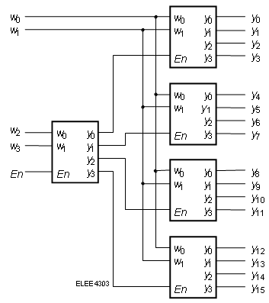
Hierarchical code for 4-16 decoder
module dec4to16 (W, En, Y);
input [3:0] W;
input En;
output [0:15] Y;
wire [0:3] M;
dec2to4 Dec1 (W[3:2], M[0:3], En);
dec2to4 Dec2 (W[1:0], Y[0:3], M[0]);
dec2to4 Dec3 (W[1:0], Y[4:7], M[1]);
dec2to4 Dec4 (W[1:0], Y[8:11], M[2]);
dec2to4 Dec5 (W[1:0], Y[12:15], M[3]);
endmodule
module dec2to4 (W, En, Y);
input [1:0] W;
input En;
output [0:3] Y;
reg [0:3] Y;
……..
……..
endmodule

Slide 22
BCD-to-7-segment code
w
3
w
2
w
1
w
0
a
b
c
d
e
f
g
0
0
0
0
1
1
1
1
1
1
0
a
a
0
0
0
1
0
1
1
0
0
0
0
w
b
0
0
1
0
1
1
0
1
1
0
1
0
c
f
b
0
0
1
1
1
1
1
1
0
0
1
w
1
w
d
g
0
1
0
0
0
1
1
0
0
1
1
2
e
e
c
0
1
0
1
1
0
1
1
0
1
1
w
3
f
g
d
0
1
1
0
1
0
1
1
1
1
1
0
1
1
1
1
1
1
0
0
0
0
1
0
0
0
1
1
1
1
1
1
1
(a) Code converter
(b) 7-segment display
1
0
0
1
1
1
1
1
0
1
1
(c) Truth table
Two types of 7-segment display
1) common-cathode: 1→on; 0→off
2) common-anode: 0→on; 1→off
anode
cathode

Slide 23
BCD-to-7-segment code
module seg7 (bcd, leds);
input [3:0] bcd;
output [1:7] leds;
reg [1:7] leds;
always @(bcd)
case (bcd) //abcdefg
0: leds = 7'b1111110;
1: leds = 7'b0110000;
2: leds = 7'b1101101;
3: leds = 7'b1111001;
4: leds = 7'b0110011;
5: leds = 7'b1011011;
6: leds = 7'b1011111;
7: leds = 7'b1110000;
8: leds = 7'b1111111;
9: leds = 7'b1111011;
default: leds = 7'bx;
endcase
endmodule
comment
w
3
w
2
w
1
w
0
a
b
c
d
e
f
g
0
0
0
0
1
1
1
1
1
1
0
0
0
0
1
0
1
1
0
0
0
0
0
0
1
0
1
1
0
1
1
0
1
0
0
1
1
1
1
1
1
0
0
1
0
1
0
0
0
1
1
0
0
1
1
0
1
0
1
1
0
1
1
0
1
1
0
1
1
0
1
0
1
1
1
1
1
0
1
1
1
1
1
1
0
0
0
0
1
0
0
0
1
1
1
1
1
1
1
1
0
0
1
1
1
1
1
0
1
1
X → don’t-care

Slide 24
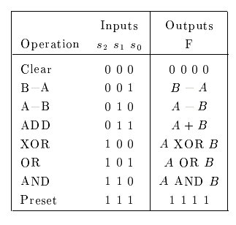
ALU — 74381
// 74381 ALU
module alu(s, A, B, F);
input [2:0] s;
input [3:0] A, B;
output [3:0] F;
reg [3:0] F;
always @(s or A or B)
case (s)
0: F = 4'b0000;
1: F = B - A;
2: F = A - B;
3: F = A + B;
4: F = A ^ B;
5: F = A | B;
6: F = A & B;
7: F = 4'b1111;
endcase
endmodule
ALU: Arithmetic Logic Unit

Slide 25
case, casez and casex
case : bit-by-bit comparison {0, 1, x, z} → can detect x and z
Example: 4’b01xz only matches 4’b01xz; 4’b0110 does not match 4’b01xx in a case
casez: treat all z (or ?) as 0, 1, x, z
Example: 4’b0110 matches 4’b01zz, but not 4’b01xz
casex: treat all z (or ?) and x (or ?) as 0, 1, x, z
Example: 4’b0110 matches 4’b01xx and also 4’b01xz

Slide 26
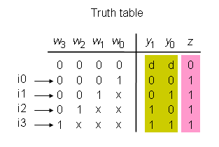
Priority encoder
module priority (W, Y, z);
input [3:0] W;
output [1:0] Y;
output z;
reg [1:0] Y;
reg z;
always @(W)
begin
z = 1;
casex(W)
4'b1xxx: Y = 3;
4'b01xx: Y = 2;
4'b001x: Y = 1;
4'b0001: Y = 0;
default: begin
z = 0;
Y = 2'bx;
end
endcase
end
endmodule
x x
x: don’t care

